Slide 1

Study on Fibonacci numbers and its application
A dissertation submitted in partial fulfillment of the requirements for degree of Bachelor of Science in Mathematics
By
Soidul Hussain
Roll No: US-191-307-0185
Paper:MAT-HE-6086
Under the guidance of
Palakshi Bora
Guest faculty
Department of Mathematics
Nowgong College
Nagaon: 782001

Slide 2
1.Introduction
The Fibonacci numbers were first discovered by Italian Mathematician Leonardo Pisano.
The Fibonacci sequence is a sequence where each term is the sum of two preceding numbers.
The Fibonacci numbers are defined by recursive relation defined by the equation Fn=fn-1+Fn-2 . For all n≥3 when F1=1,F2=1.Where Fn represents the nth Fibonacci numbers .
The Fibonacci numbers can elaborately written as 1,1,2,3,5,8,13,21,34,55…..

Slide 3
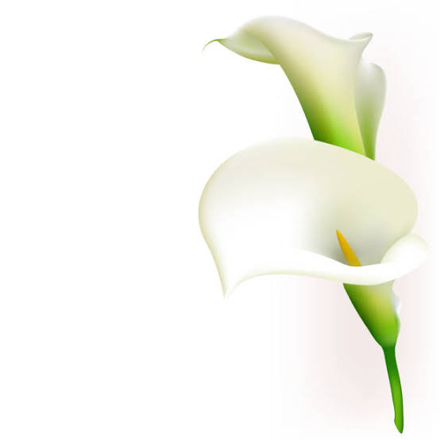
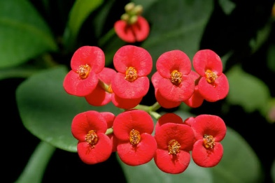
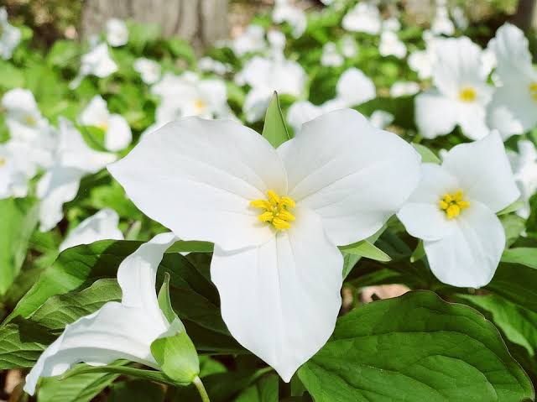
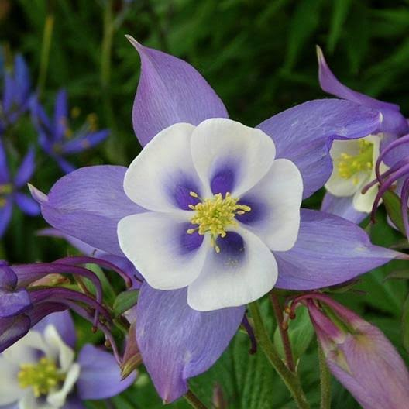
2.Fibonacci sequence in Nature
Fibonacci can be found in nature
The number of petals of flowers are related with Fibonacci numbers.
For example
1 petals : white cally lily
2 petals: Euphorbia
3 petals: Trillium grandiflorum
5 petals : columbine, periwinkle
8 petals: cosmosbipinnatus
1 petal
2 petals
3 petals
5 petals

Slide 4
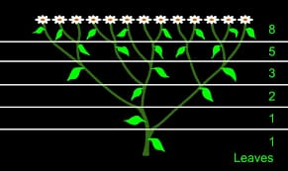
3.Plants also show the Fibonacci numbers in the arrangement of their leaves .

Slide 5
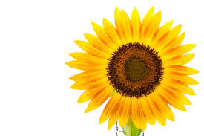
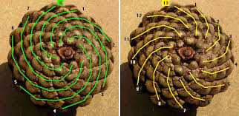
4.Fibonacci spiral
The Fibonacci numbers are found in the arrangement of seeds on flower heads.
There are 55 spirals spiraling outwards and 34 spirals spiraling inwards in most daisy or sunflower blossoms.
The Fibonacci numbers can also be find in pineapple .

Slide 6
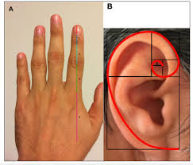
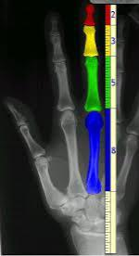
5.Organ of Human body
Human exhibit fibonacci characteristics.
Every human has two hands,
Each one of these hands has five fingers and
Each finger has three parts which are separate by two knuckles
All of these numbers fit into the Fibonacci sequence. Moreover
The length of bones on a hand are in Fibonacci numbers.
The cochlear of the inner ear forms a golden spiral

Slide 7
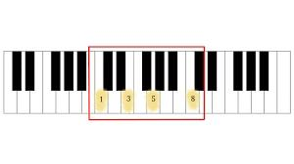
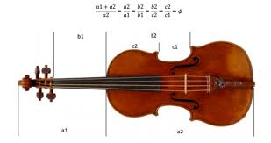
6. Fibonacci in Music.
The Fibonacci sequence of numbers and the golden ratio are manifested in music widely.
The numbers are presented in the octave.
The foundational unit of melody and harmony stradivariuos Used the golden ratio to make the greatest string instruments over created.
The composer used the golden ratio and Fibonacci numbers to structure his music.

Slide 8
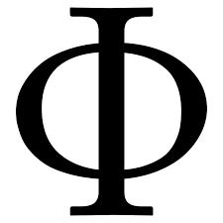
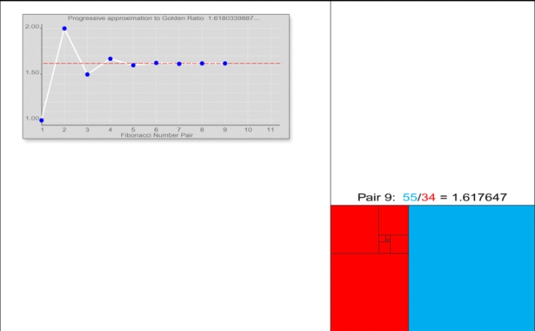
7.The golden ratio
Represent by the Greek letters Phi( =1.6180339887
How did 1.6180339887 come from?
Let’s look at the ratio of each number in the Fibonacci sequence to the one before it.
1/1=1,2/1=2,3/2=1.5,5/3=1.666,8/5=1.666,13/8=1.625,.....
If we keep going,we get an interesting number which mathematics call 'phi’
i.e Golden ratio or Golden ratio =1.6180339887
Lim_{n→infinity}F_{n+1}/Fn=1.618

Slide 9
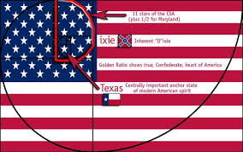
8.Application of Golden ratio
The golden ratio is widely used in geometry.
It is the ratio of the side of a regular Pentagon to its diagonal.
The diagonal cut each other with the golden ratio. Pentagon described a star which form parts of many flag

Slide 10
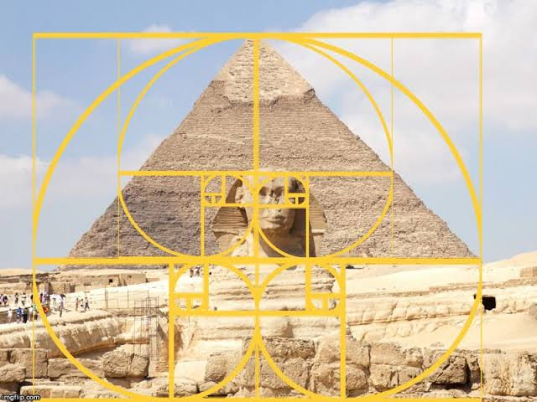
9.The golden ratio is also frequently seen in nature.
It can be found in great Pyramid of Egypt . Perimeter of the pyramid divided by twise it’s vertical height in the value of Phi .

Slide 11
10. Fibonacci in coding
Recently Fibonacci sequence and golden ratio are of great interest to the researchers in many fields series including in energy physics,
Quantum mechanics
Cryptography and
Coding

Slide 12
11. A simple example
Find the Fibonacci series next 6 terms 0,1,1,2,3,....
Sol^{n}
Sum of the preceding Two Fibonacci terms are the next term in the series
i.e F1=0, F2=1, F3=1, F4= 2, F5=3
F6=F4+F5=2+3=5
F7=F5+F6=3+5=8
F8=F6+F7=5+8=13. and so on
Therefore the Fibonacci series will be 0,1,2,3,5,8,13,......

Slide 13
Conclusion
The Fibonacci numbers are Nature’s numbering system. They appear everywhere in Nature, from the leaf arrangement in plants, to the pattern of the florets of a flower, the bracts of a pinecone, or the scales of a pineapple. The Fibonacci numbers are therefore applicable to the growth of every living thing, including a single cell, a grain of wheat, a hive of bees, and even all of mankind.But very little we observe the beauty of nature.
. If we study the pattern of various natural things minutely we observe that many of the natural things around us follow the Fibonacci numbers in real life which creates strange among us.
The study of nature is very important for the learners. It increases the inquisitiveness among the learners. The topic is chosen so that learners could be interested towards the study of nature around them. .Security in communication system is an interesting topic at present as India is going towards digitalization.

Slide 14
Let us finish by the words of Leonardo da Vinci “Learn how to see, Realize that everything connects to everything else”.

Slide 15
References
Bortner, Cashous W. And Peterson, Allan C., 2016, The History and Applications of Fibonacci Numbers. UCARE Research Products. 42. (http://digitalcommons.unl.edu/ucareresearch/42)
Garg, M, Garg, P, Vohra, R. K., 2014, Advanced 4 sequence with Golden Ratio, International Journal of Scientific & Engineering Research, Vol 5(6), 388-391.
.
Gend ,V,R., 2014 The Fibonacci sequence and the golden ratio in music, Notes on Number Theory and Discrete Mathematics,Vol.20(1), 72–77.

Slide 16
My Special Thanks Of Gratitude
To
Palakshi Bora
who supervised the study I have
done for the dissertation.
I also thank
HoD Dilip Kumar Bora
and
Dr. P.Senapati
for their suggestions and encouragement..

